Slide 1
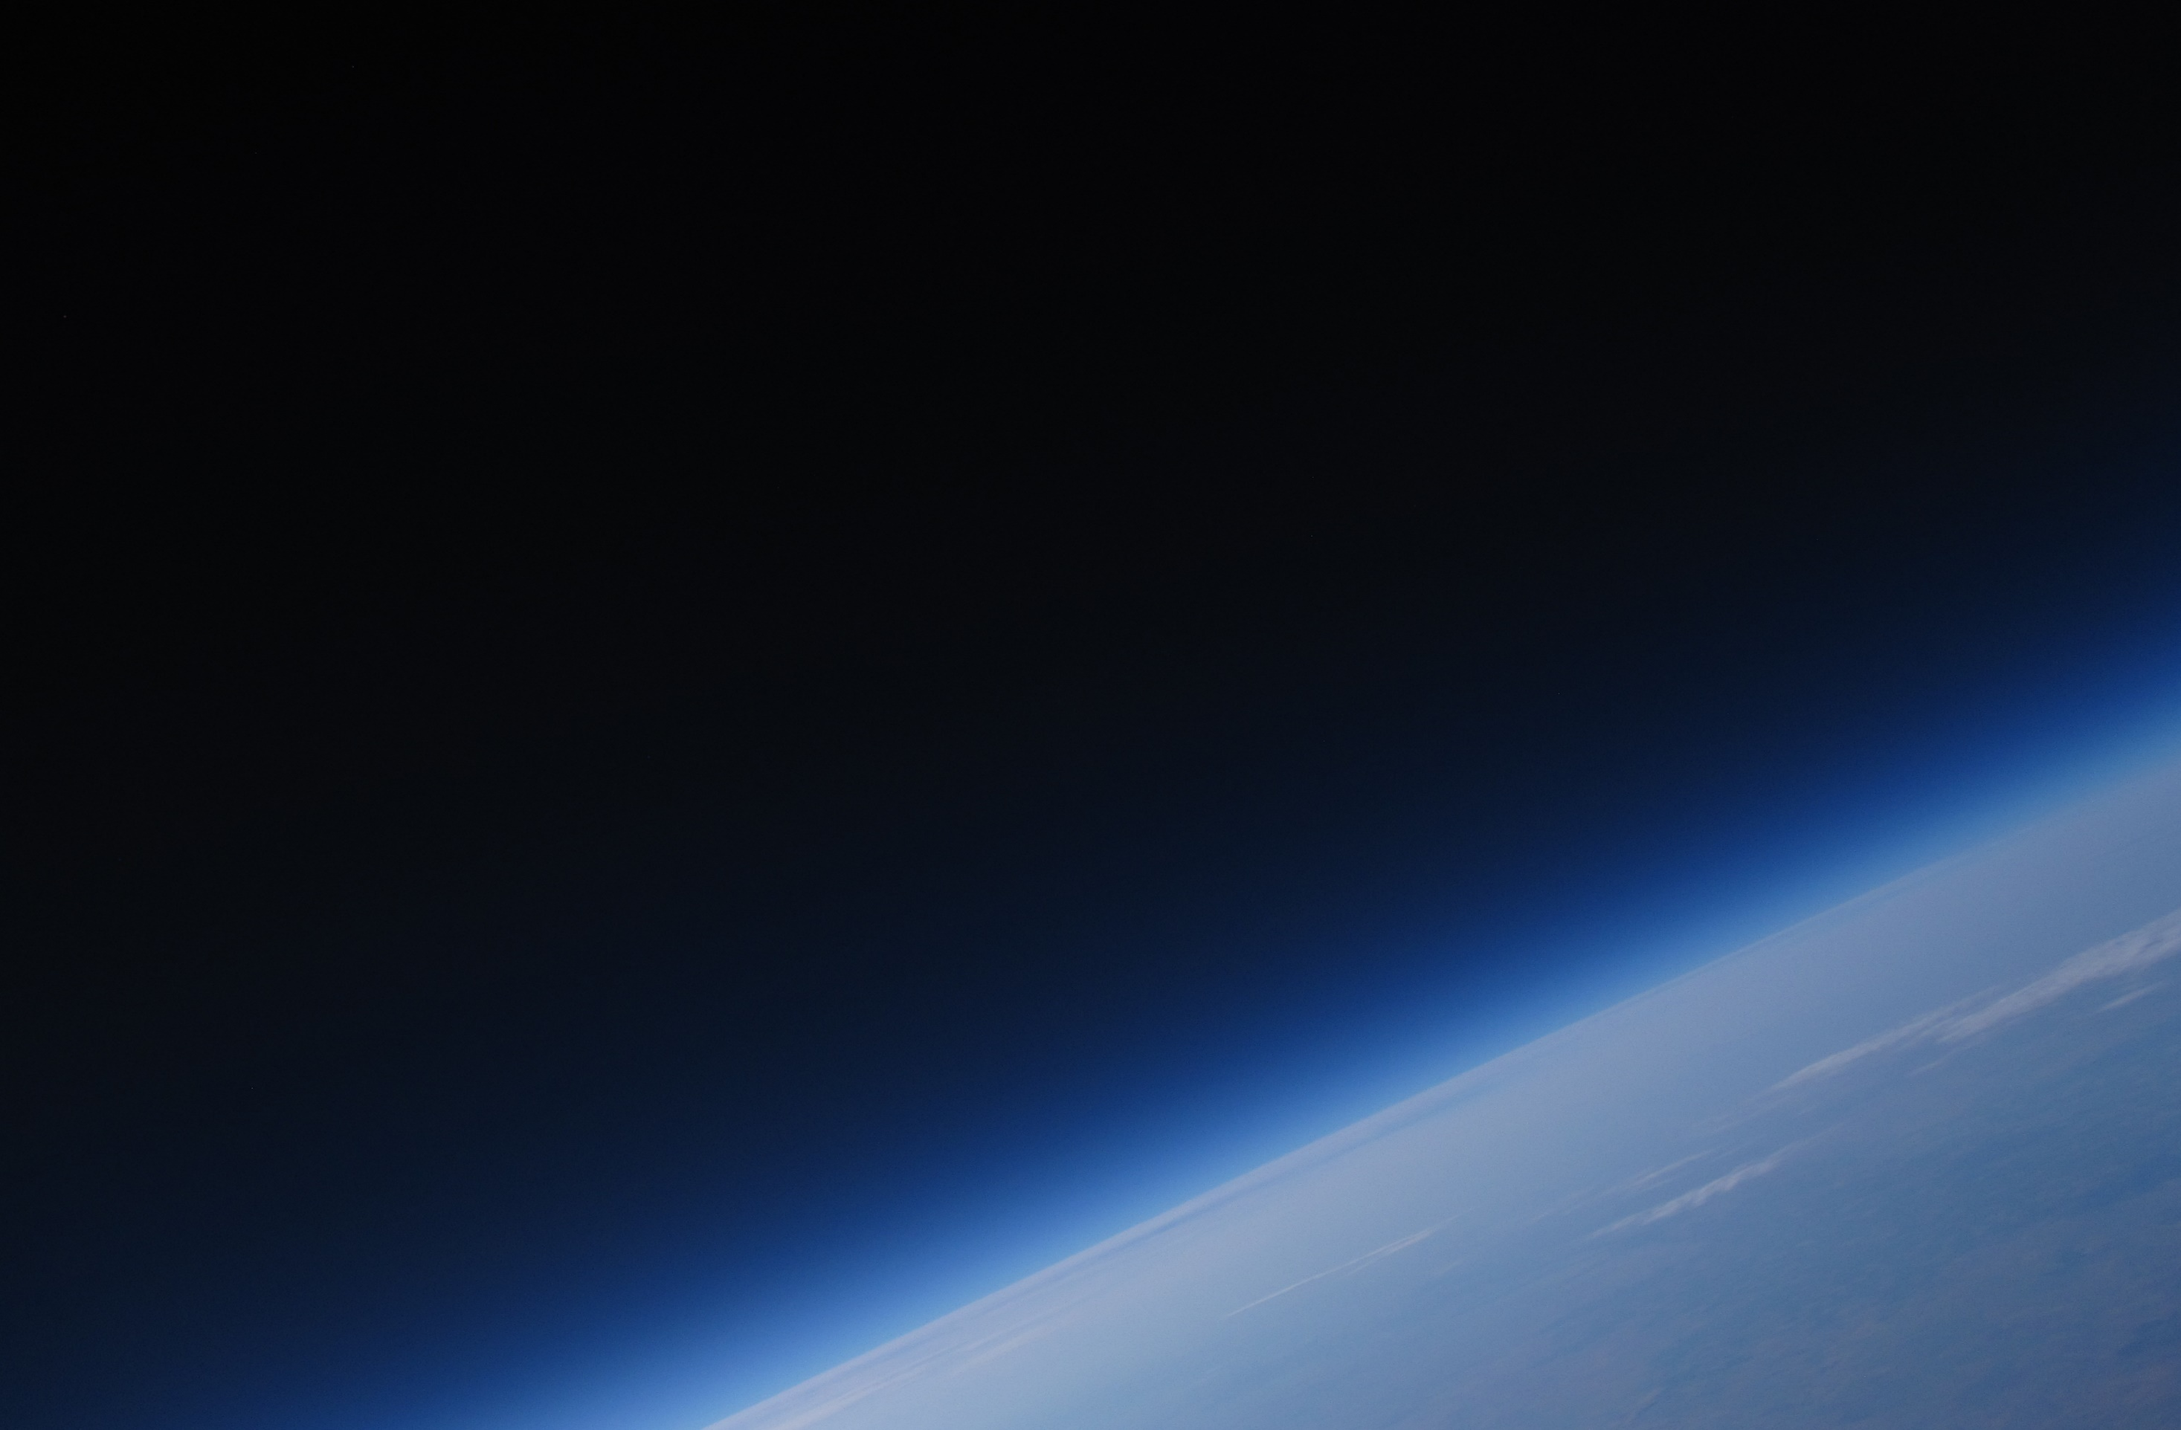
Atmospheric Investigations
Terry Deshler, Katie Foster: University of Wyoming
Aeriana, Barak, Britney, Cody, Collin, Emy, JT, Mia, Tim: ESP
Buoyancy Force – Why balloons work: Barak, Emy
Advection Calculations – Where will the instruments go: Collin, Tim
Balloon logistics: Inflation, Release, Recovery: Mia, Cody, Aeriana
What we measured and learned: JT, Britney

Slide 2
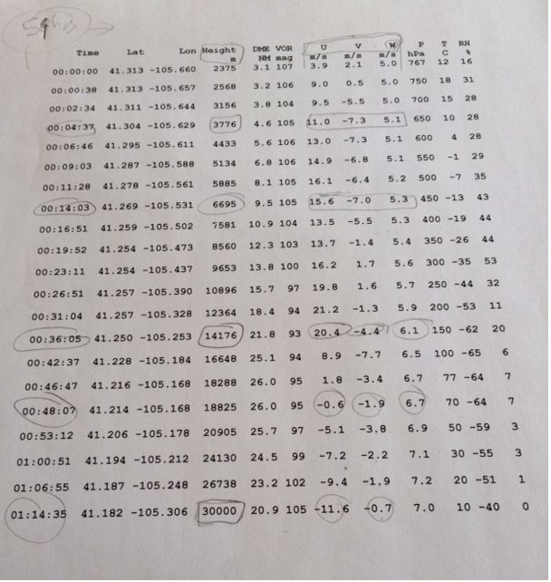

Slide 3
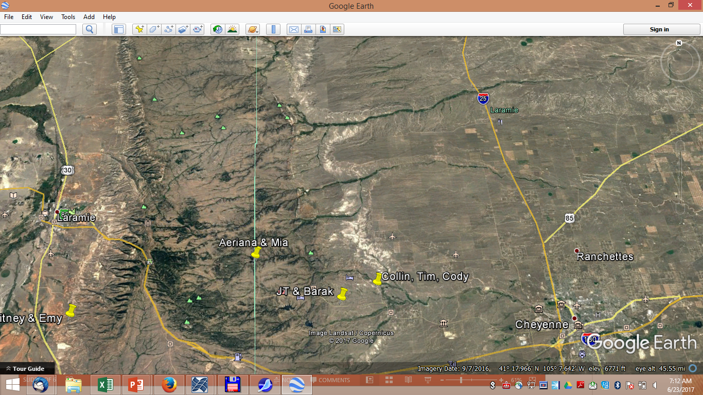

Slide 4
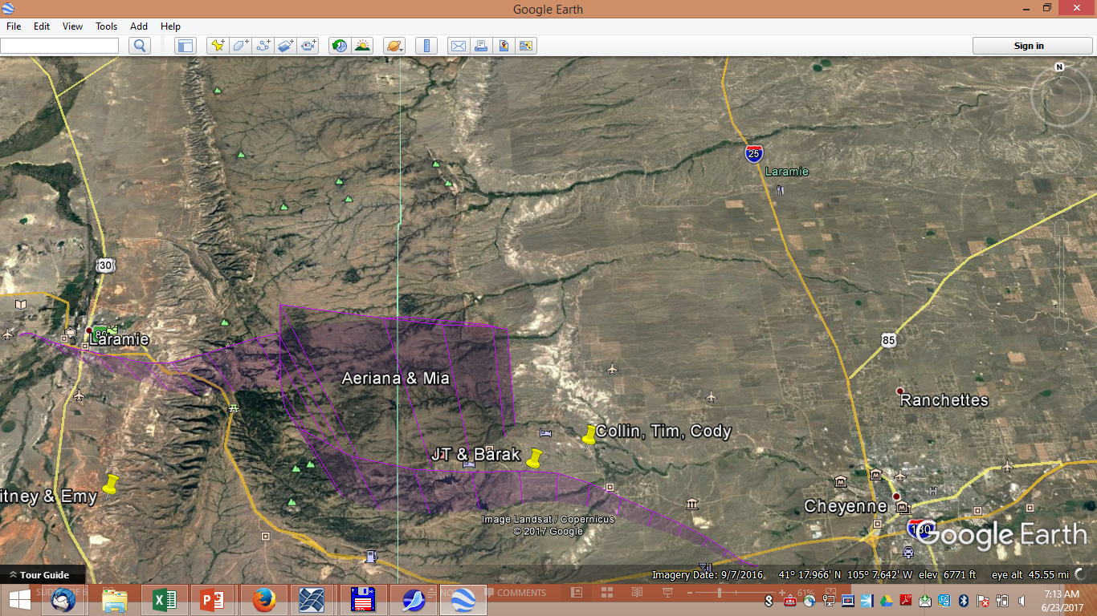
54 hour forecast

Slide 5
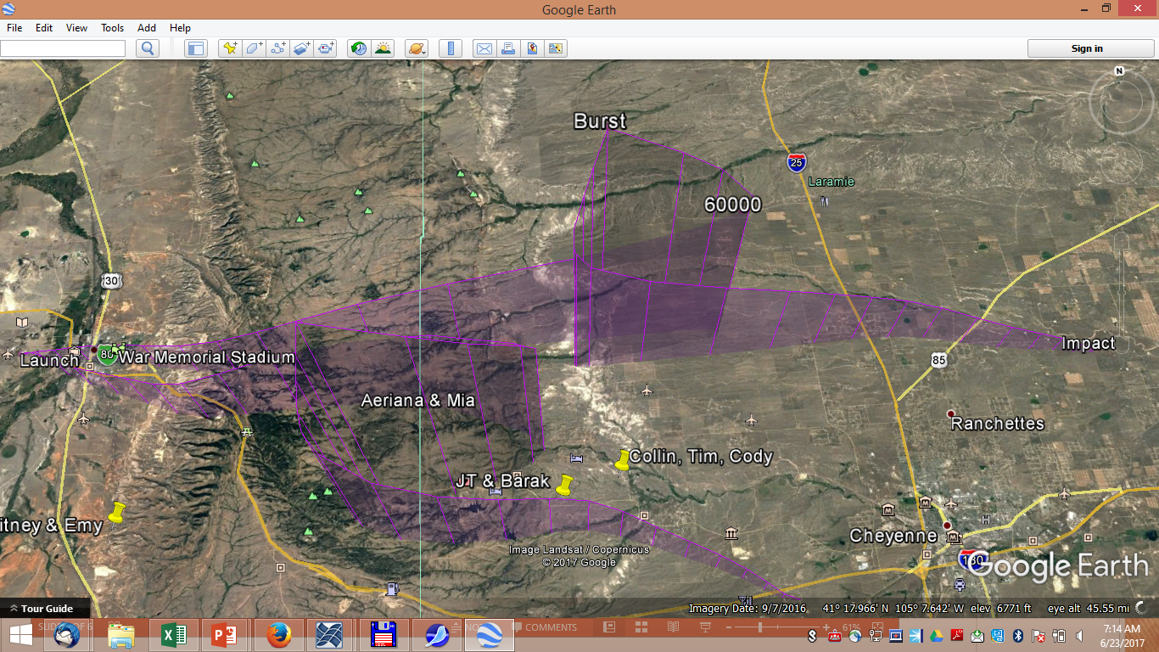
6 hour forecast
54 hour forecast

Slide 6
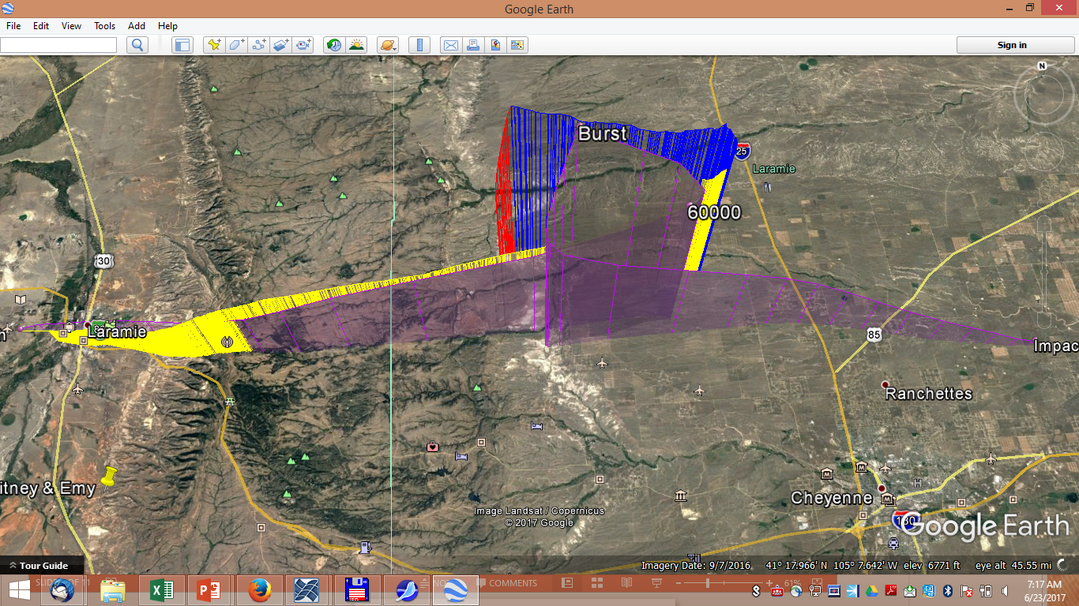

Slide 7
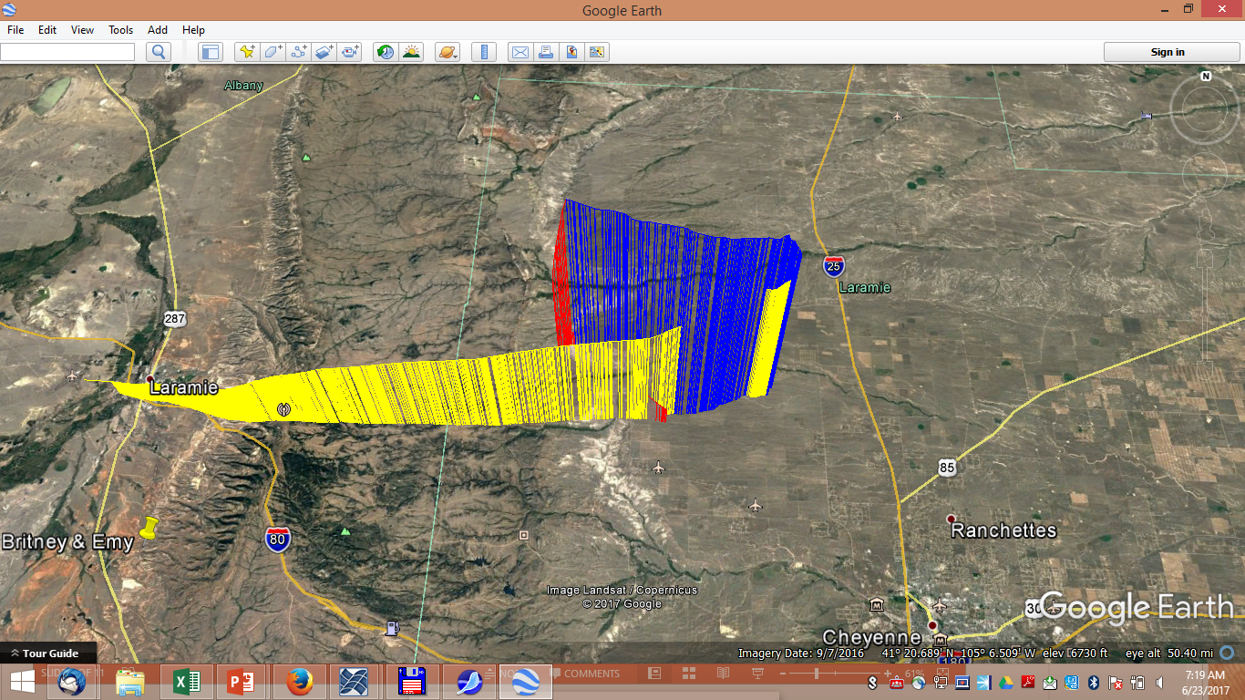

Slide 8
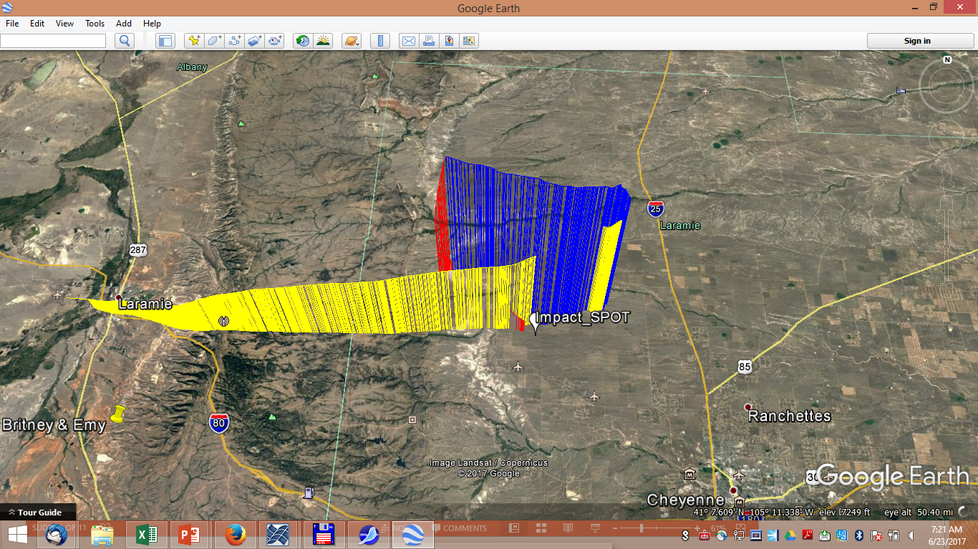

Slide 9
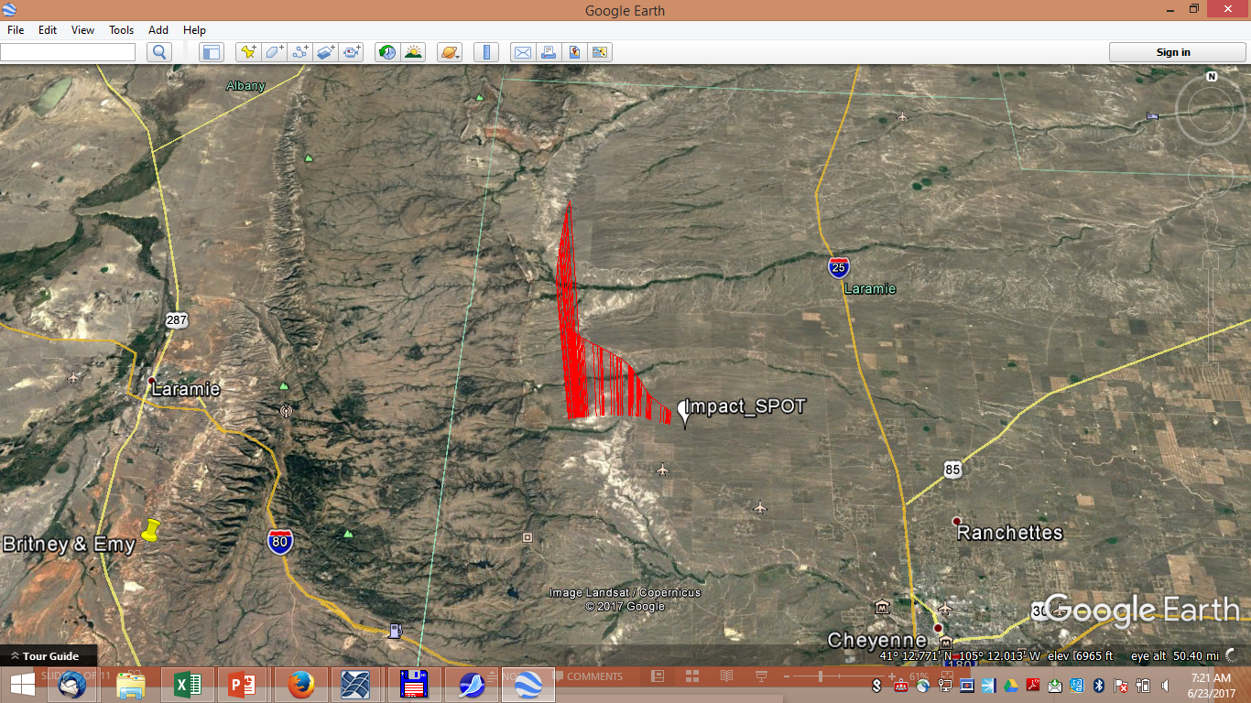

Slide 10
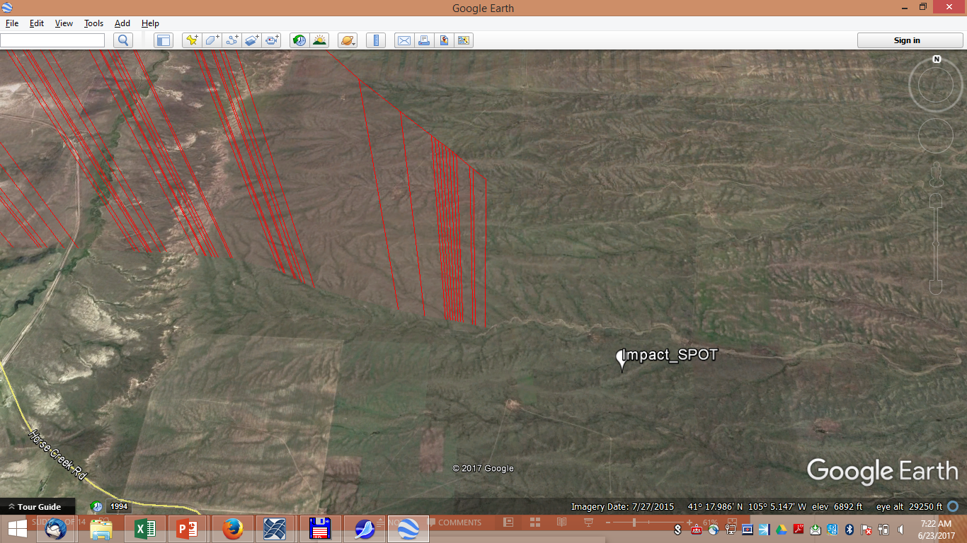

Slide 11
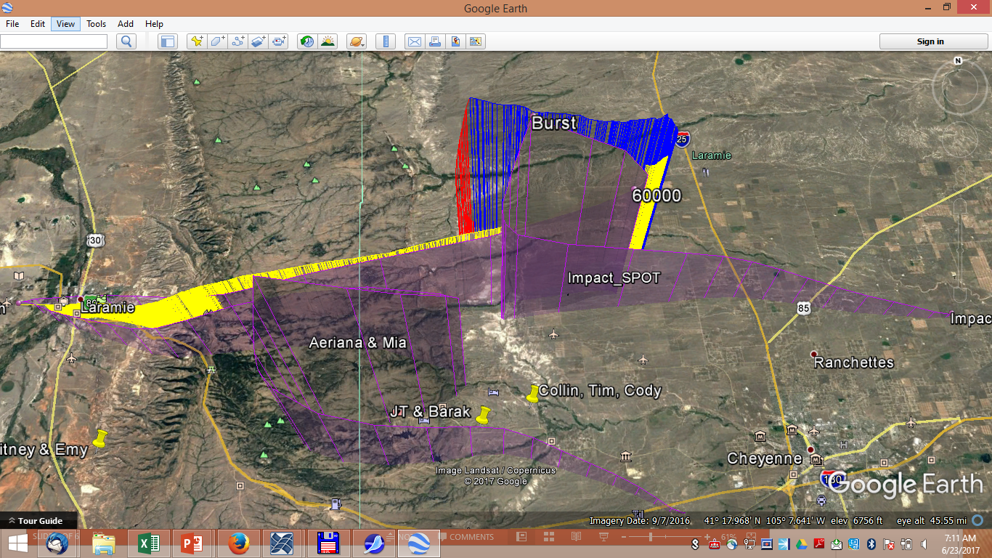

Slide 12
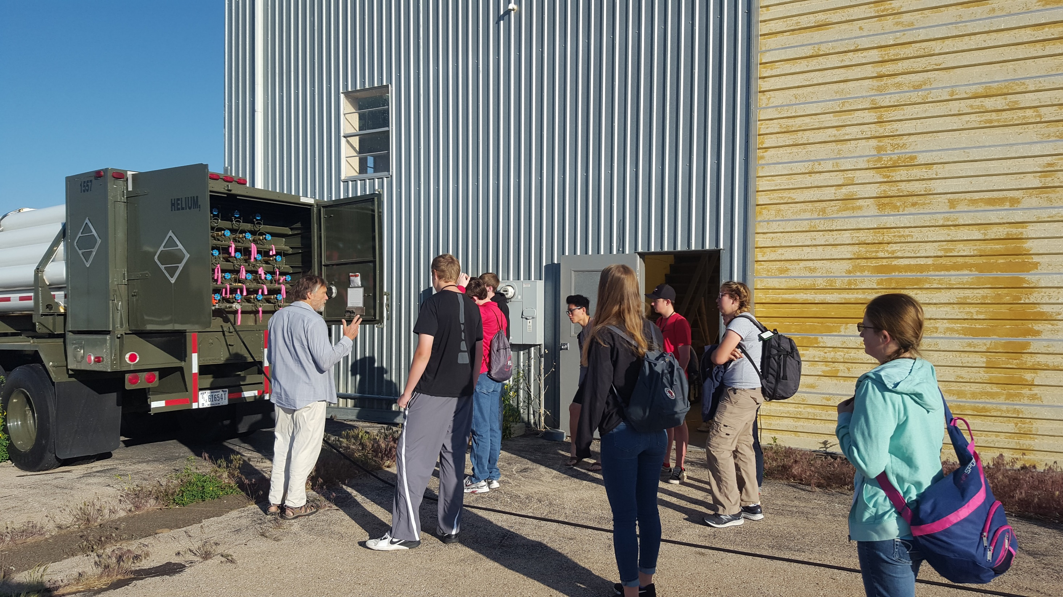

Slide 13
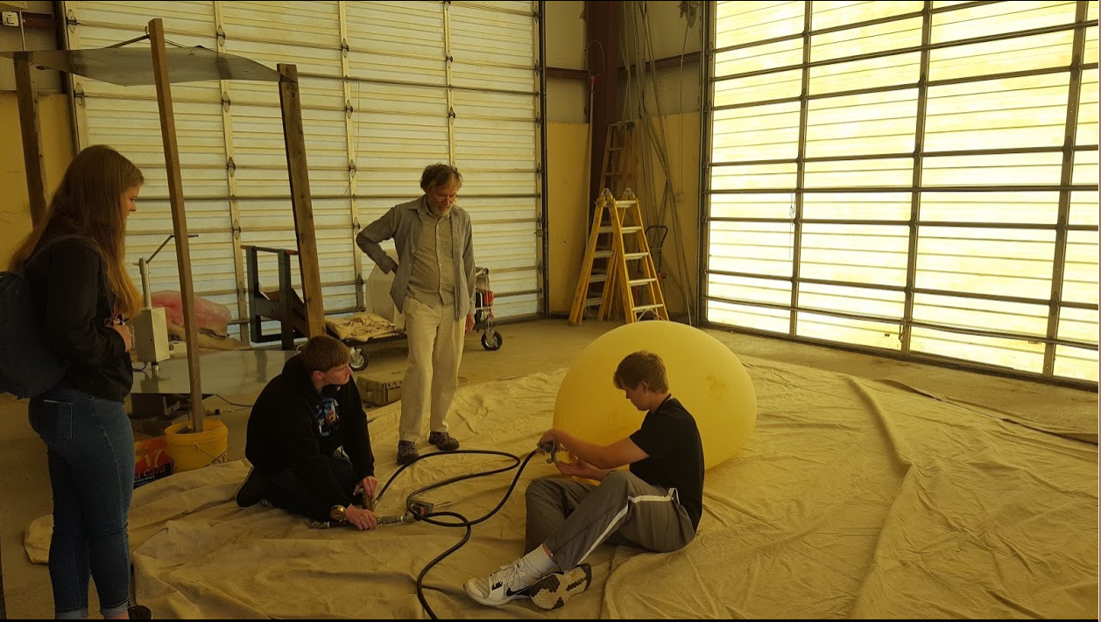

Slide 14
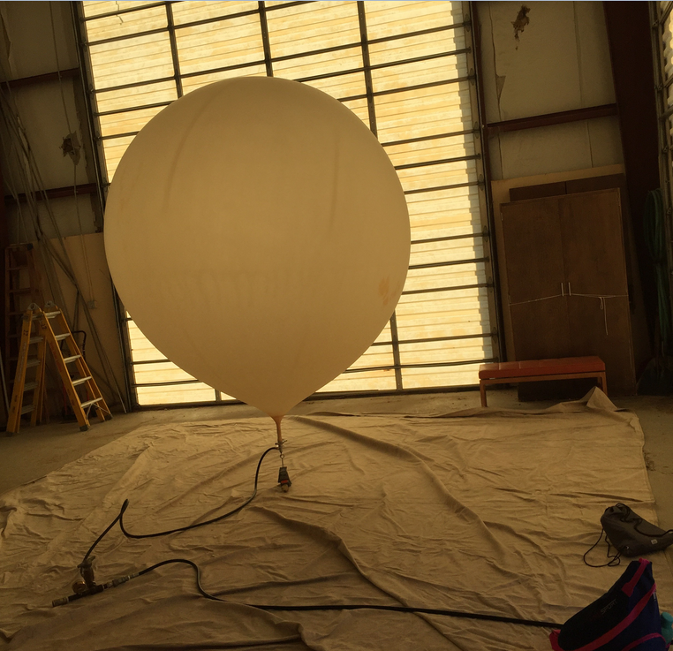
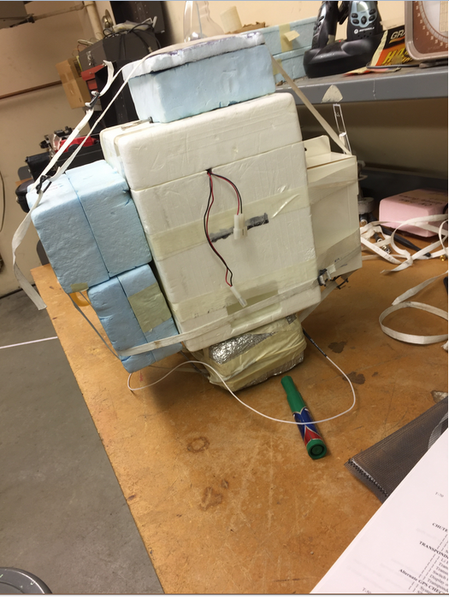

Slide 15
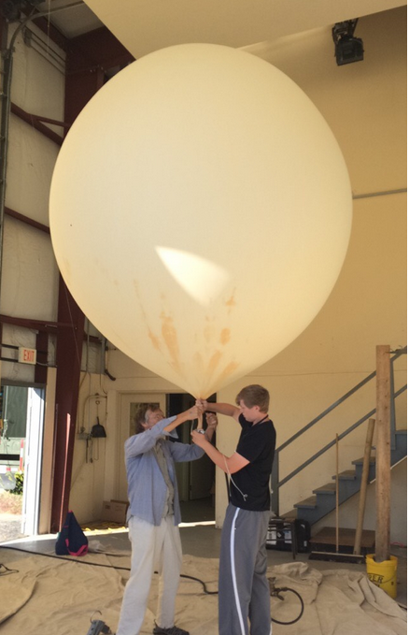
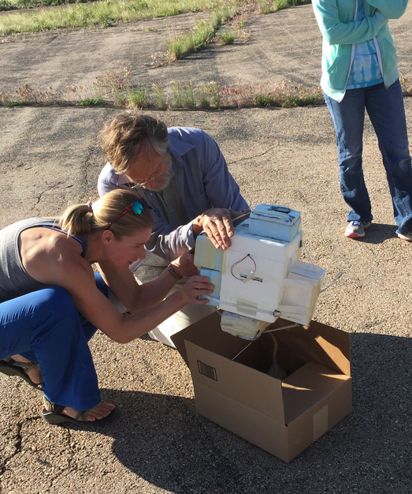

Slide 16
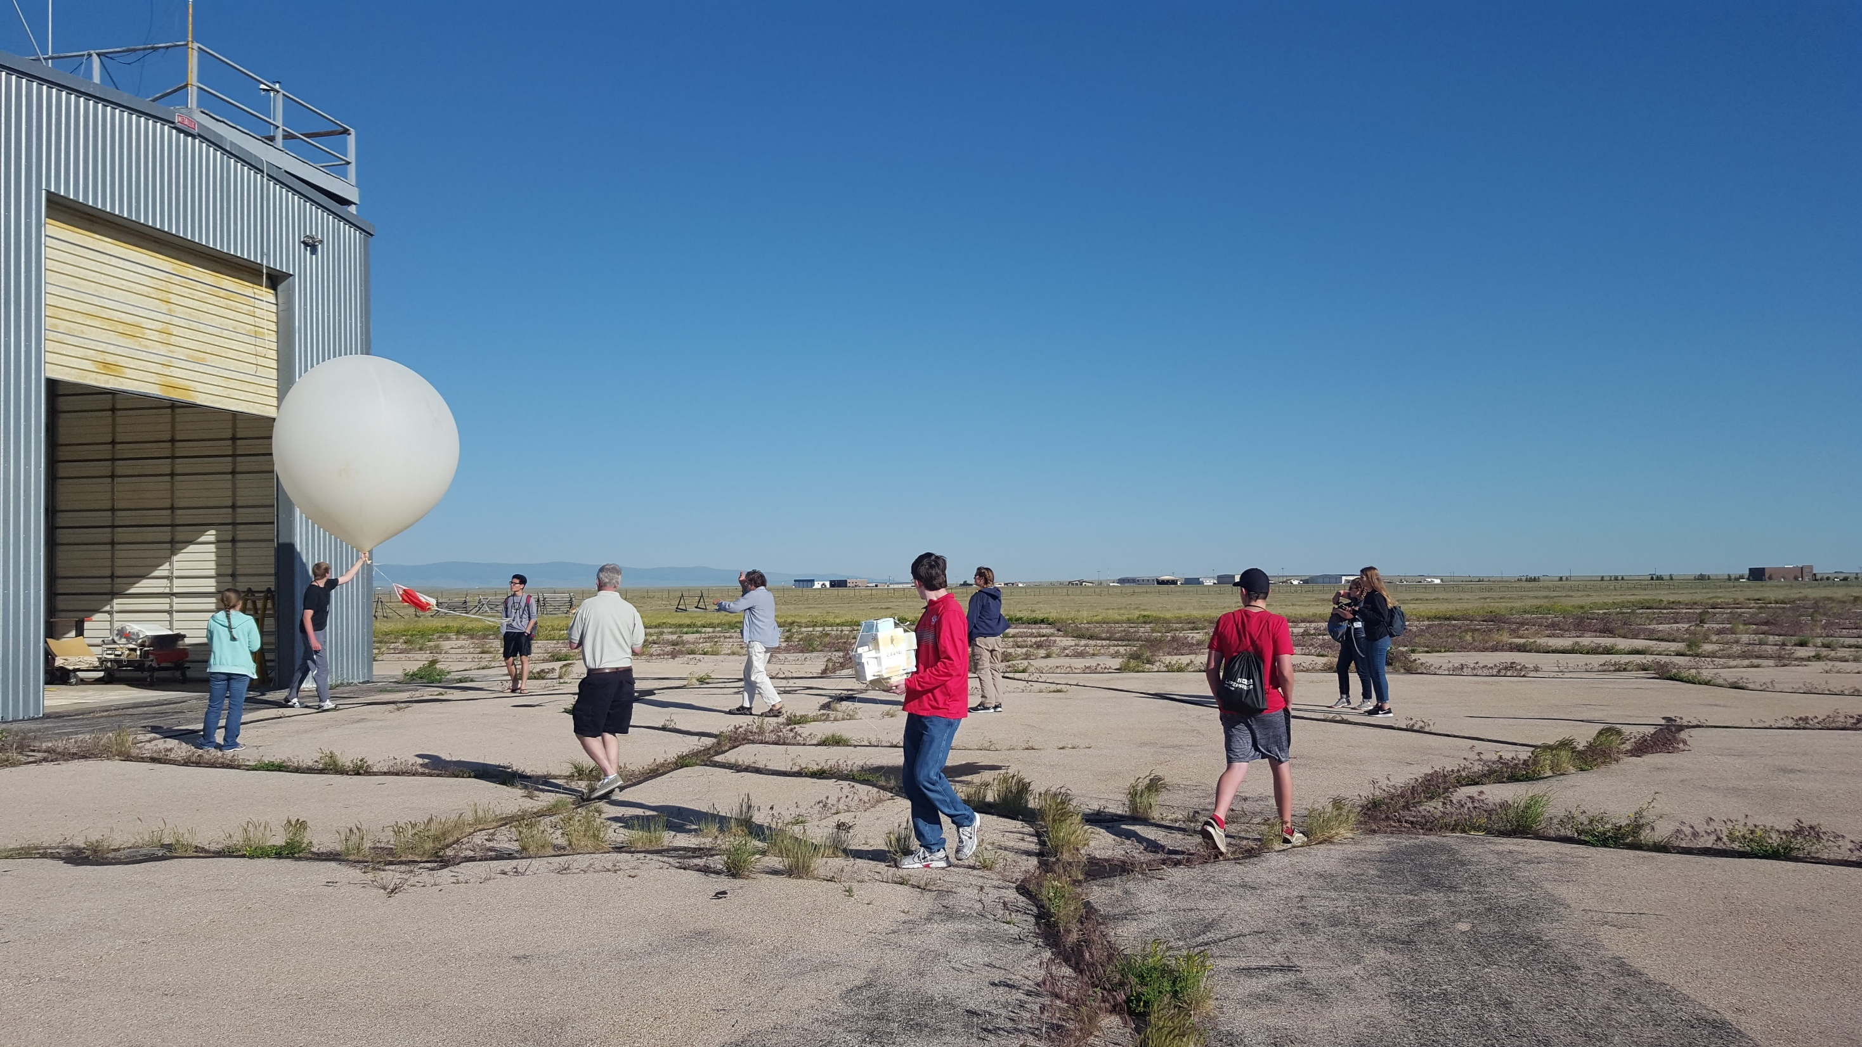
Launch Video - Cody
Launch Video Katie

Slide 17

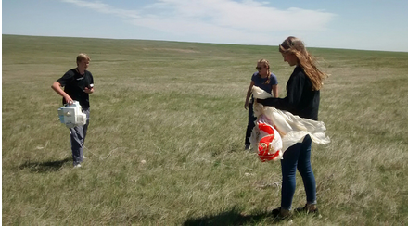

Slide 18
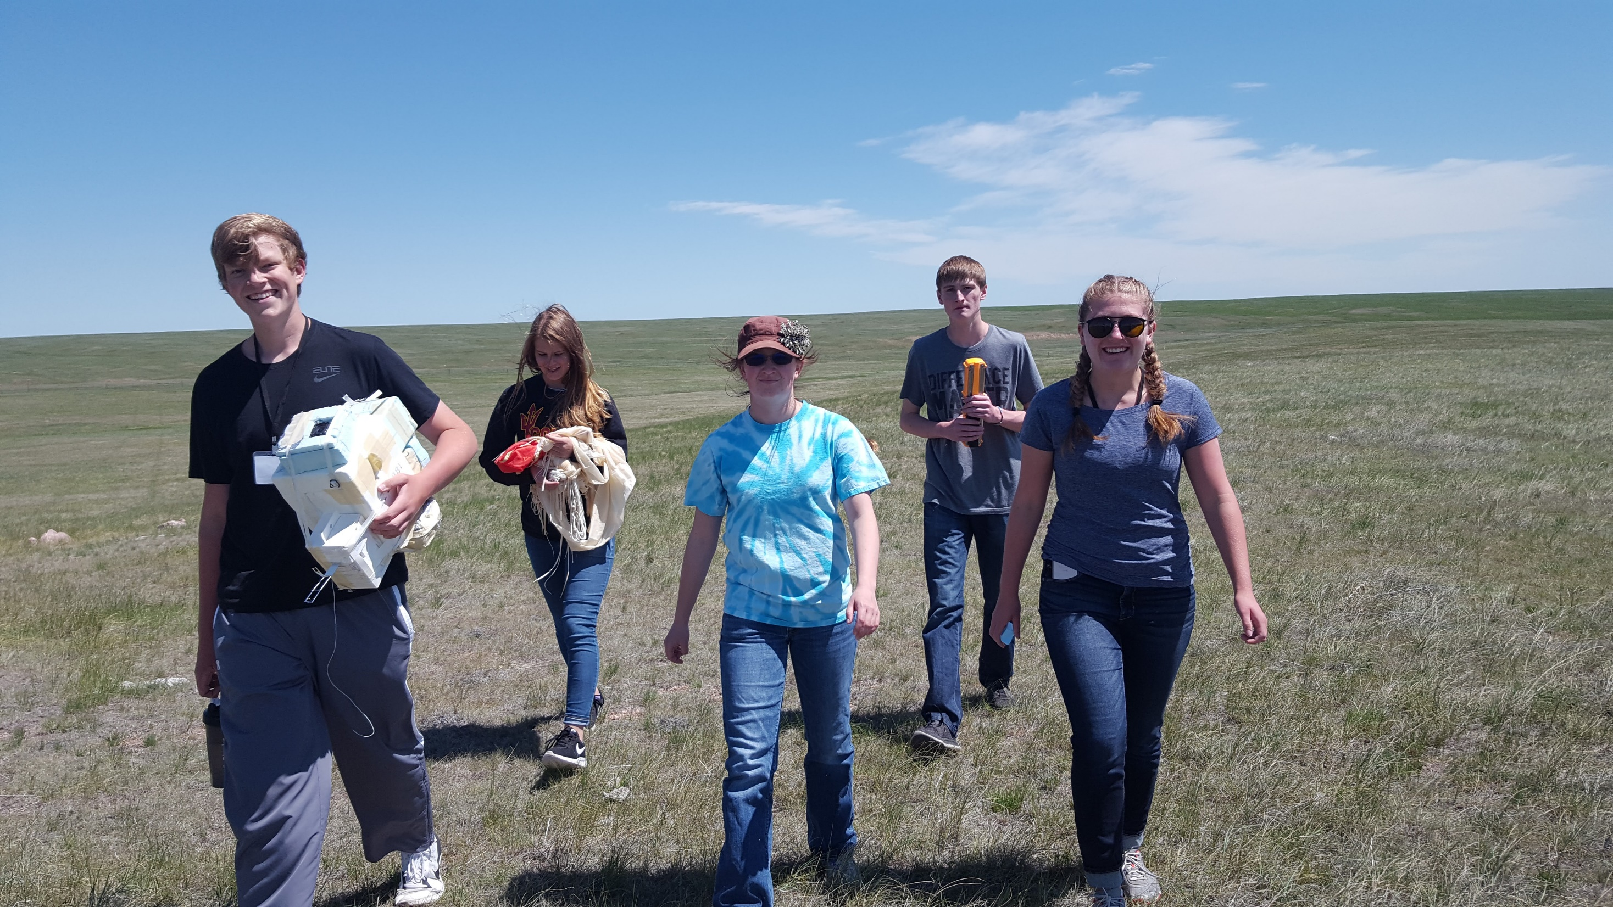

Slide 19
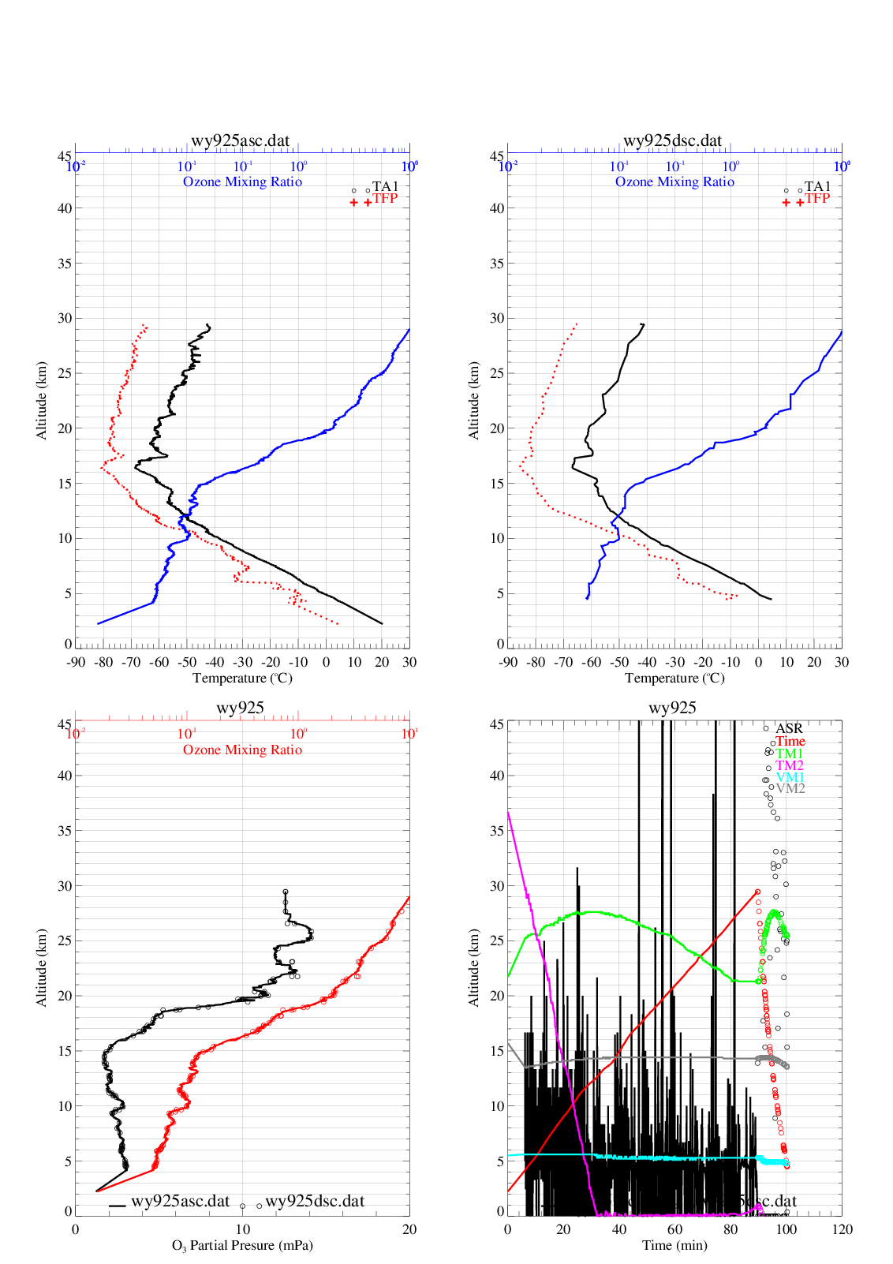
Ascent
Descent
June 22, 2017
June 22, 2017
Dew Point
Temperature
Ozone
Dew Point
Temperature
Ozone

Slide 20
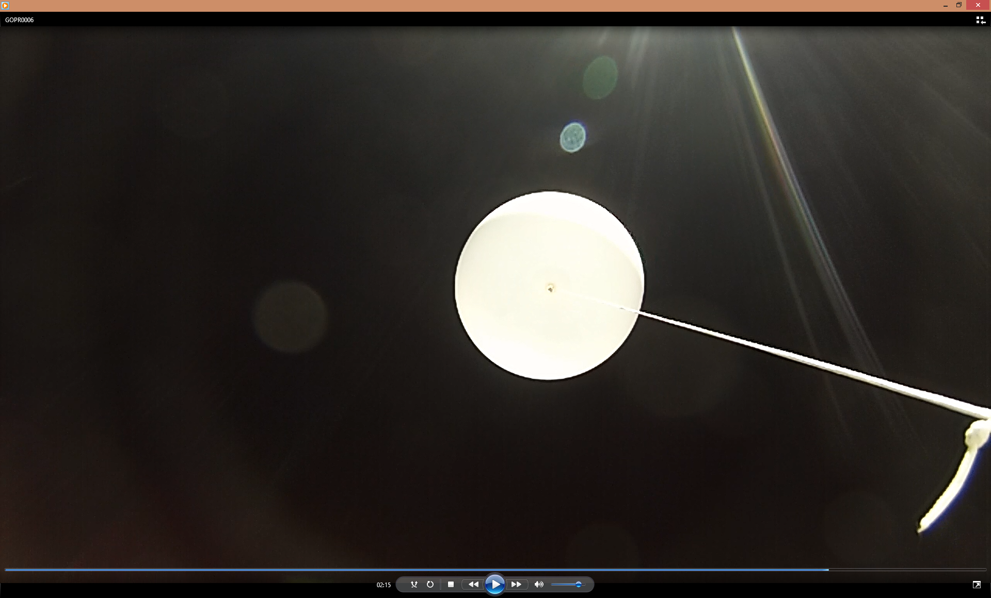
ESP 2016 Burst

